Slide 1
LO: grouping data

Slide 2
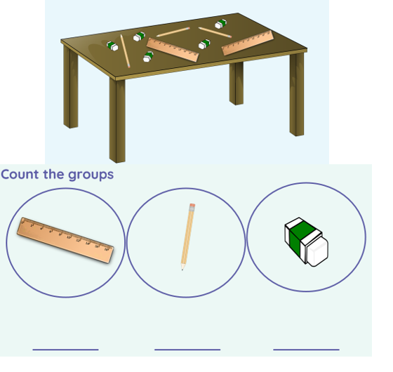
Using this worksheet in the pack, group these objects.

Slide 3
Computers work the same, they group and count data too!

